Slide 1
Calendar Scheduling and Alarm System in Python
A Comprehensive Event Scheduling and Reminder Application with GUI
Presented by: Sriram k s , yaswant r , saicharan a s
Date Of presentation : 25/11/2024

Slide 2
Introduction
Purpose: This project focuses on developing a Python-based calendar scheduling and alarm system. It allows users to manage events, set notifications, and handle recurring tasks.
Objectives:
• Implement an intuitive graphical user interface (GUI) for event management.
• Provide desktop notifications when events are due.
• Enable daily, weekly, and monthly recurring events.
• Search events by title or date.

Slide 3


Project Requirements
Software Requirements:
• Python 3.x
• tkinter for GUI
• plyer for notifications
• datetime for handling dates and times
• json for data storage
Hardware Requirements:
• Standard computer system with Python installed.

Slide 4

Problem Statement
Problem:
• Manual scheduling can be time-consuming and error-prone.
• Users often forget important events without reminders.
• Need for a simple solution that can handle recurring events efficiently.
Solution:
A Python-based scheduling system that automates event management and reminds users of upcoming tasks through desktop notifications.

Slide 5
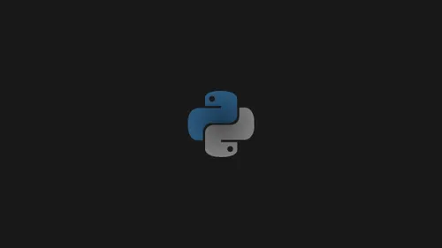

System Architecture
A flowchart illustrating the system:
1. Event Creation - GUI input
2. Data Storage - JSON file to save events
3. Alarm Checker - Continuously checks current time
4. Desktop Notification - Triggers if the time matches

Slide 6
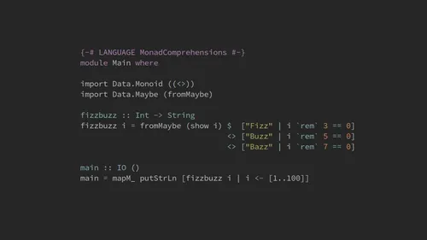
Project Features
• Event Scheduling: Add, edit, and delete events with ease.
• Desktop Notifications: Timely notifications for upcoming events.
• Recurring Events: Manage events that repeat daily, weekly, or monthly.
• Search Functionality: Search for specific events by title or date.

Slide 7
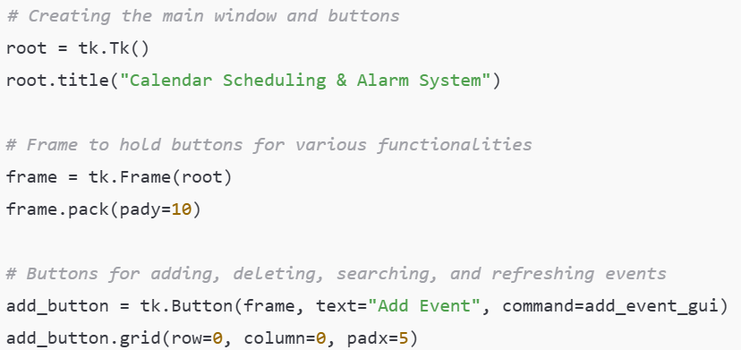
Implementation - Code Overview
User Interface (tkinter):

Slide 8
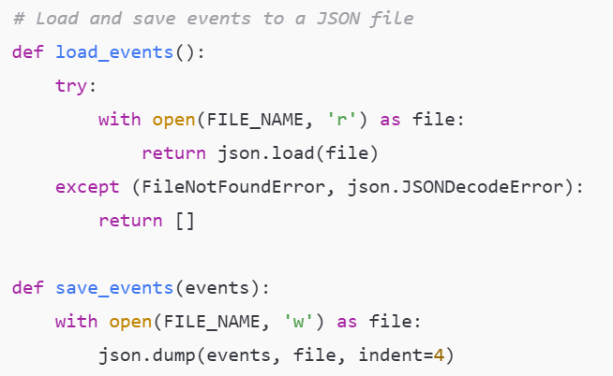
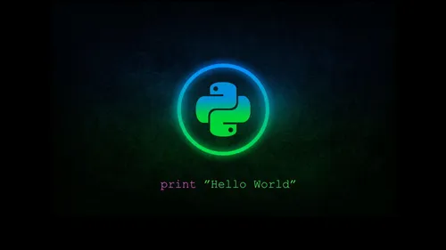
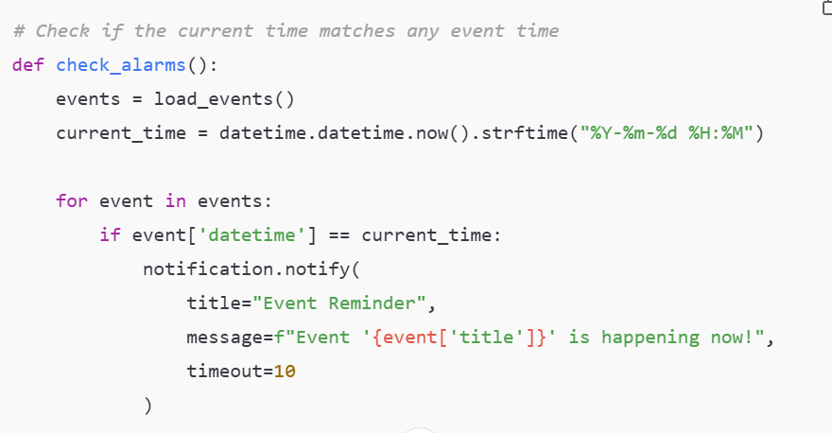
Data Handling ( JSON )
Alarm Trigger (date & time)

Slide 9
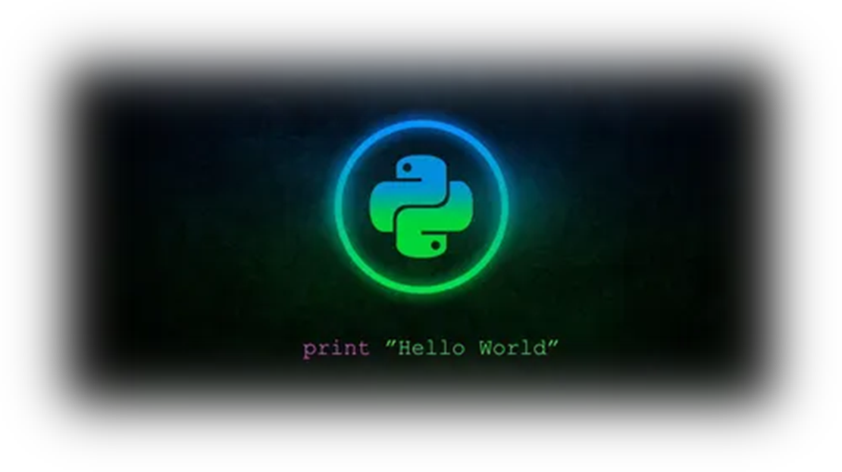
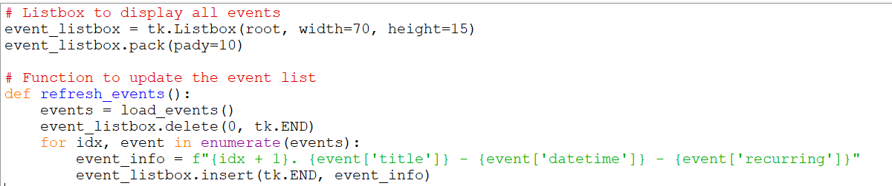
Graphical User Interface (GUI)
The GUI is built using tkinter to create a user-friendly interface.
Key features include:
• A main window with buttons to add, delete, search, and refresh events.
• A listbox displaying scheduled events.

Slide 10
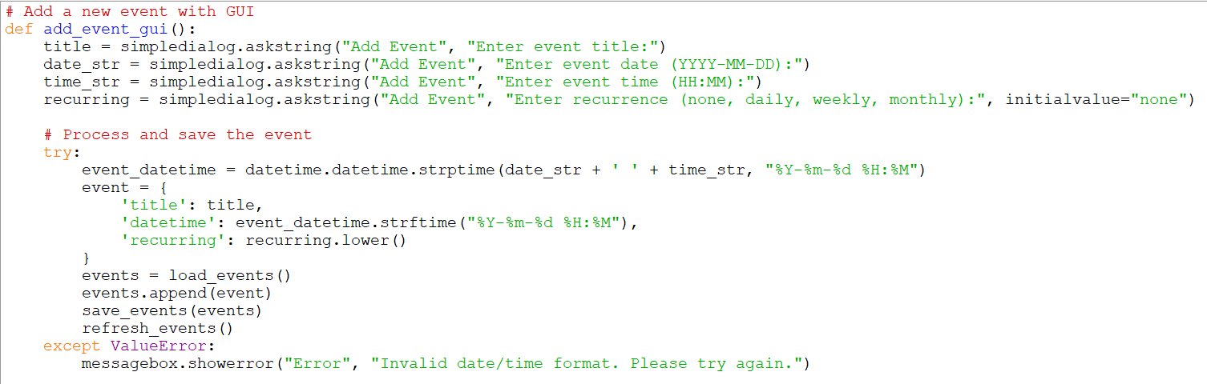
Event Scheduling and Notifications
Users can add events by specifying the title, date, time, and recurrence pattern. Notifications pop up at the event time using plyer.

Slide 11

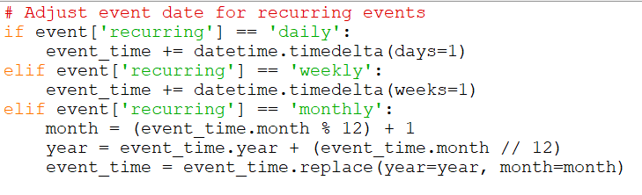
Recurring Events Handling
Users can select a recurrence pattern (daily, weekly, monthly). The system automatically adjusts the date for the next event when triggered.

Slide 12
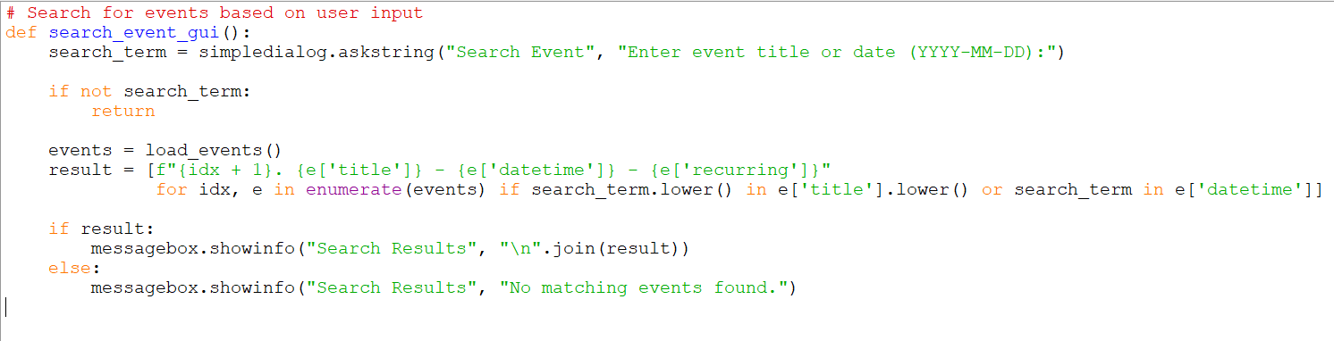
Search Functionality
Users can search for events by entering a title or date. The search results are displayed in a popup

Slide 13

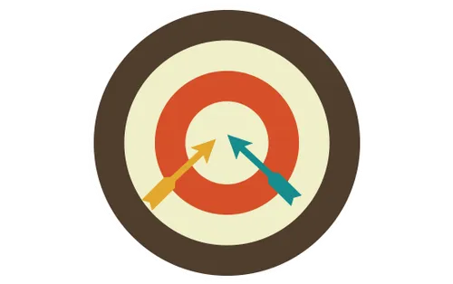
Challenges Faced
• Time Management: Ensuring the alarm system efficiently handles multiple events.
• Date and Time Handling: Parsing and comparing date/time values without errors.
• Recurring Events Complexity: Properly adjusting dates for recurring events.

Slide 14
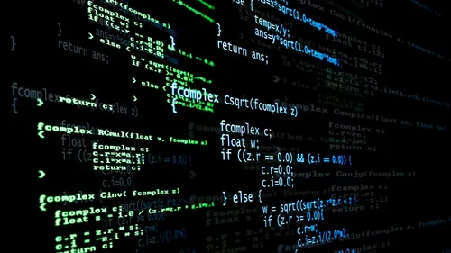
Future Improvements
• Enhanced Recurrence: Add support for custom intervals (like bi-weekly).
• Sound Notifications: Integrate sounds with desktop notifications.
• Database Integration: Shift from JSON to SQLite for better data management.

Slide 15
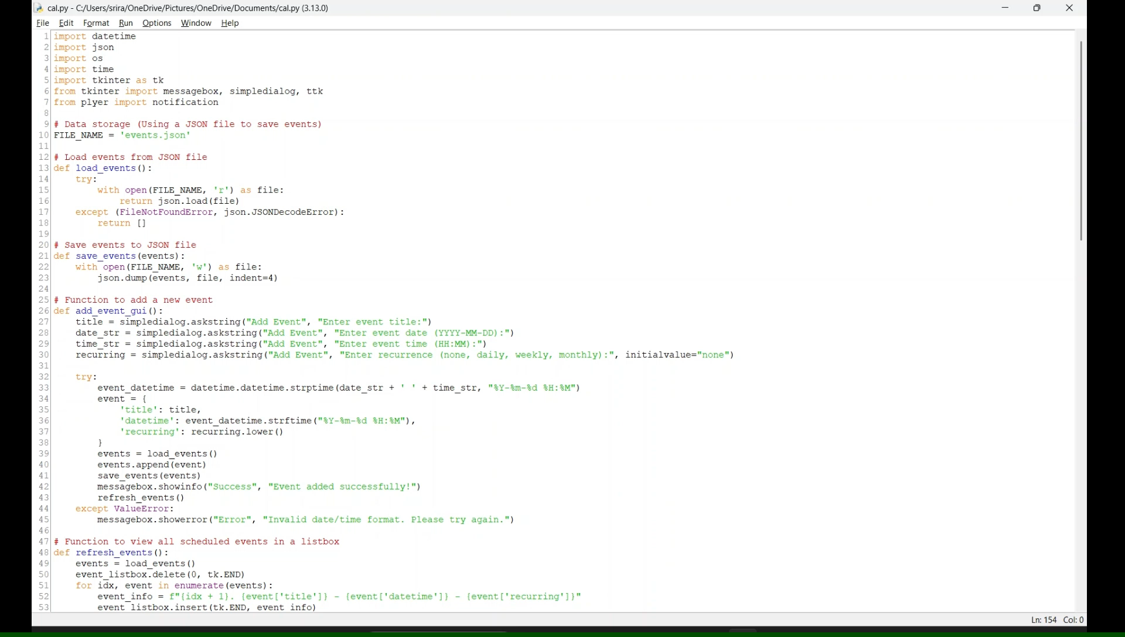
Demonstration

Slide 16
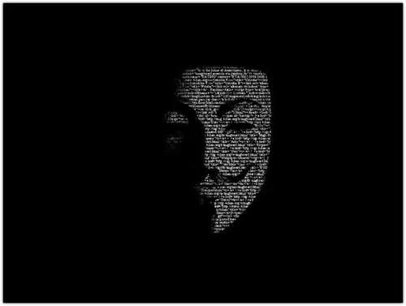
Conclusion
Summary:
• Successfully developed a Python application for event scheduling and reminders.
• Implemented GUI, notifications, recurring events, and search functionality.
• Learning Experience: Insights on time management, GUI design, and data handling.

Slide 17

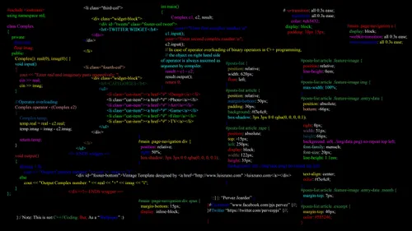
References
1. Python Documentation (https://docs.python.org)
2. tkinter Documentation (https://docs.python.org/3/library/tkinter.html)
3. plyer Documentation (https://plyer.readthedocs.io)
4. JSON Handling in Python (https://docs.python.org/3/library/json.html)
5. Stack Overflow - Community Q&A (https://stackoverflow.com)
Project URL : https://github.com/sriramks06/Python-Project-PPS-.git

Slide 18
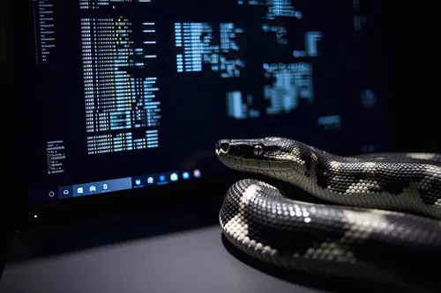
Thank You

